Slide 1
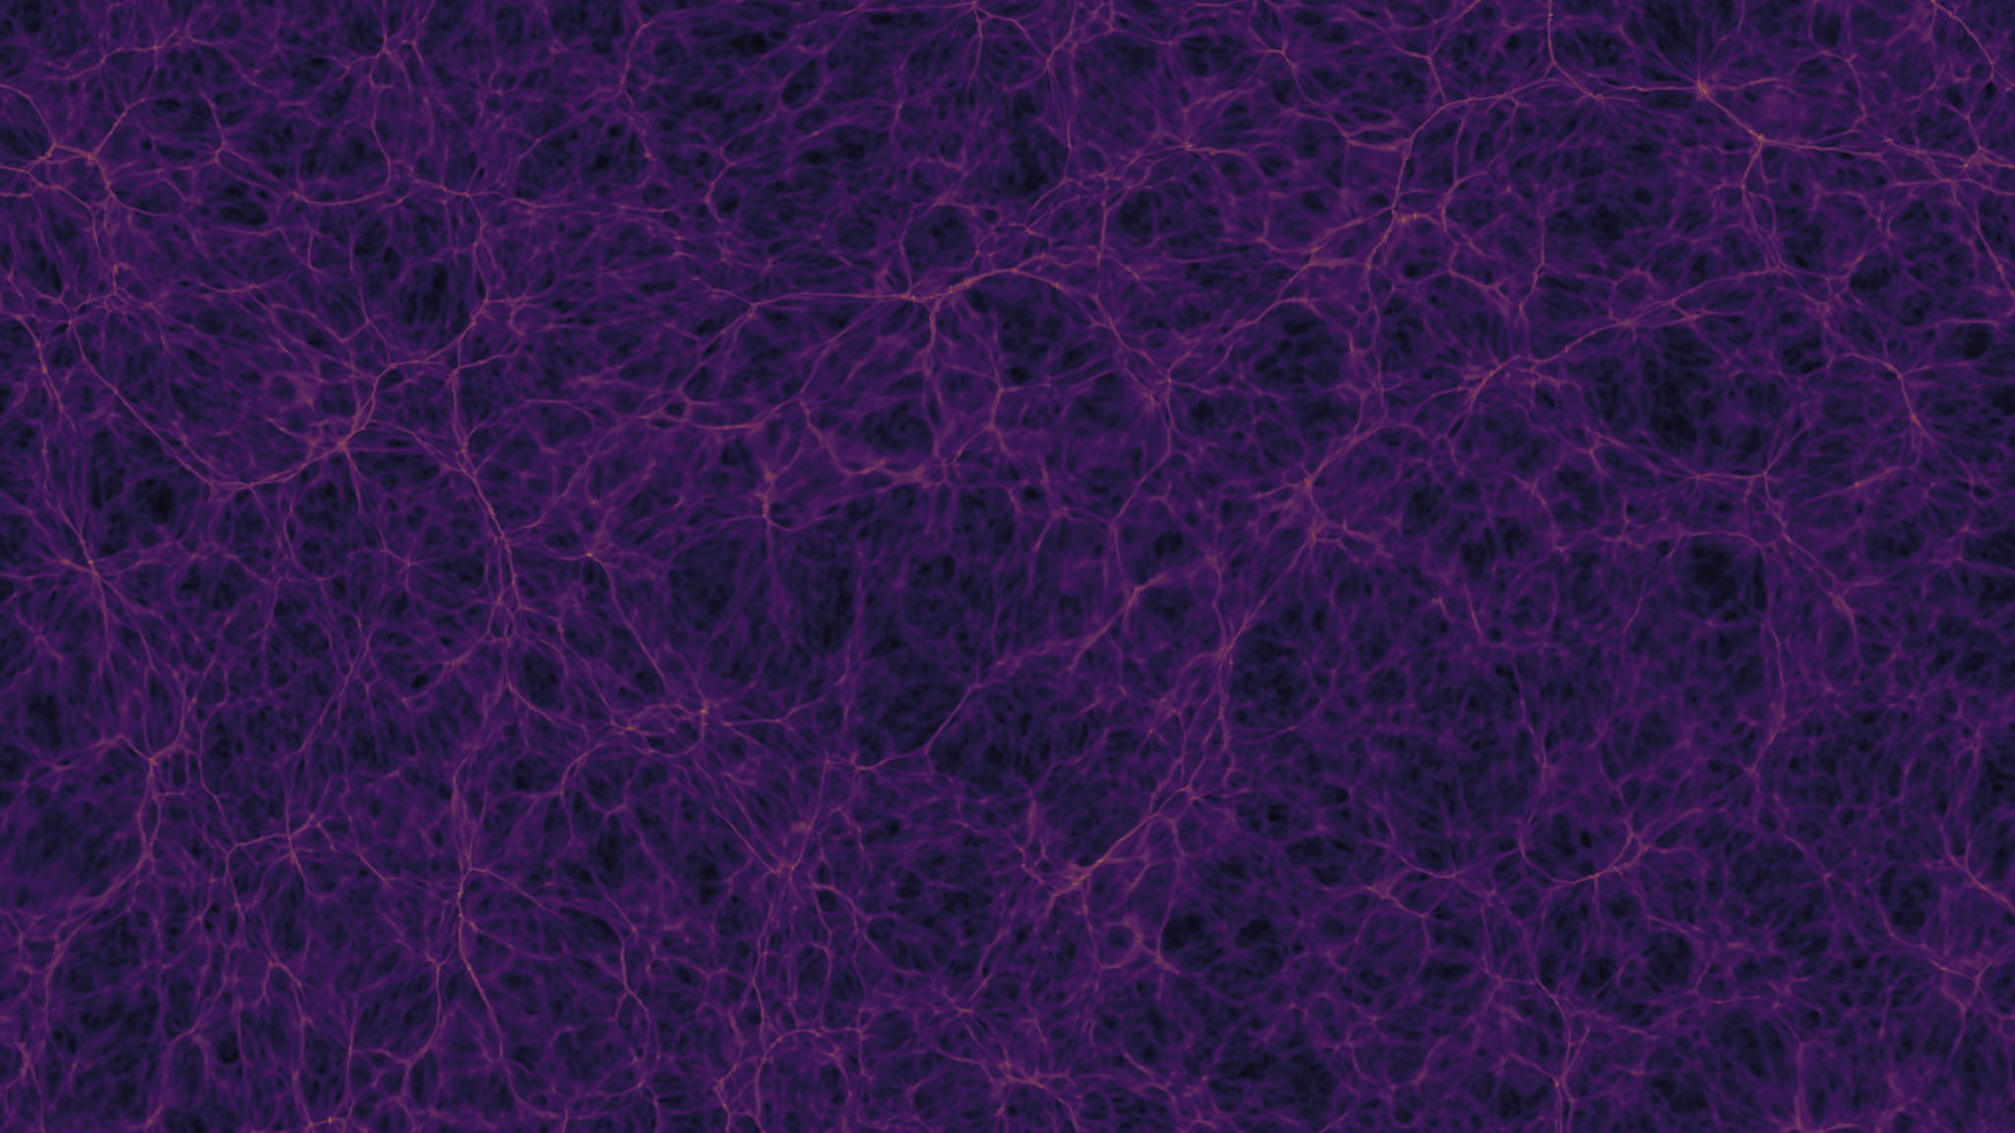
Gravitational Impact of the Death Star on Endor and Earth-like planets
A Scientific Exploration Using Newtonian Mechanics
By: Simon Tebeck, Pranav Gupta
Team Name: The Skywalkers
PI: Prof. Oliver Beckstein
https://github.com/Py4Phy/final-2024-the-skywalkers
Notes:
Minimum 9 minutes
Good morning, everyone. Today, I will be presenting our findings from a simulation study on the gravitational effects of the Death Star, a massive space station, on its surrounding celestial bodies.

Slide 2
Background
Problem Statement: Investigate the gravitational impact of the Death Star on nearby celestial bodies like Earth and Endor.
Equations Used: Newton's Law of Universal Gravitation: F= GMm/r^2 Equations of Motion for Circular Orbits: F = ma
Motivation: Understanding these effects is crucial for predicting potential real-world outcomes in similar massive body interactions within a planetary system.
Notes:
> To set the stage, let's discuss why this study is important. The Death Star, as depicted in popular media, is an enormous structure capable of influencing gravitational fields. Using Newton’s Law of Universal Gravitation and equations of motion, we explored its potential impacts on planetary bodies.
> This study not only satisfies scientific curiosity but also helps in understanding how large artificial satellites could affect their environment

Slide 3

Methods
Algorithms: Velocity Verlet Integration for accurate motion simulation.
Libraries Used: NumPy for numerical operations. Matplotlib for plotting and animations.
Flow Diagram: Initialization → Calculate Forces → Integrate Motion → Update Positions → Repeat
Notes:
> Our approach involved several key steps. We used the Velocity Verlet integration algorithm for precise motion simulation, considering the masses and distances of Earth, its moon, Endor, and the Death Star.
> We performed these calculations using Python, with libraries like NumPy for numerical operations and Matplotlib for visualization.
> Here's a brief snippet of our code, demonstrating how we applied Newton's gravitational formula to update the velocities and positions of each celestial body in our simulation.

Slide 4
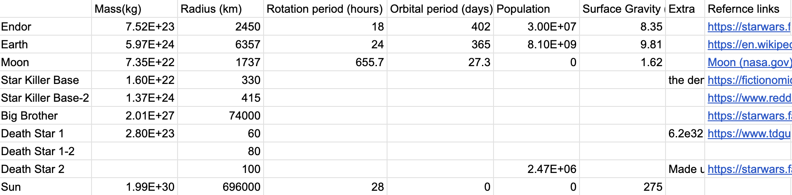
Results - Task 1 (Data Collection)
Collected the required information form fan pages, reddit and publicly available data for Masses, distances,
Notes:
> We collected mass, radius and other available data on endor, star killer base, death star, big brother tana, earth, moon, and sun.

Slide 5
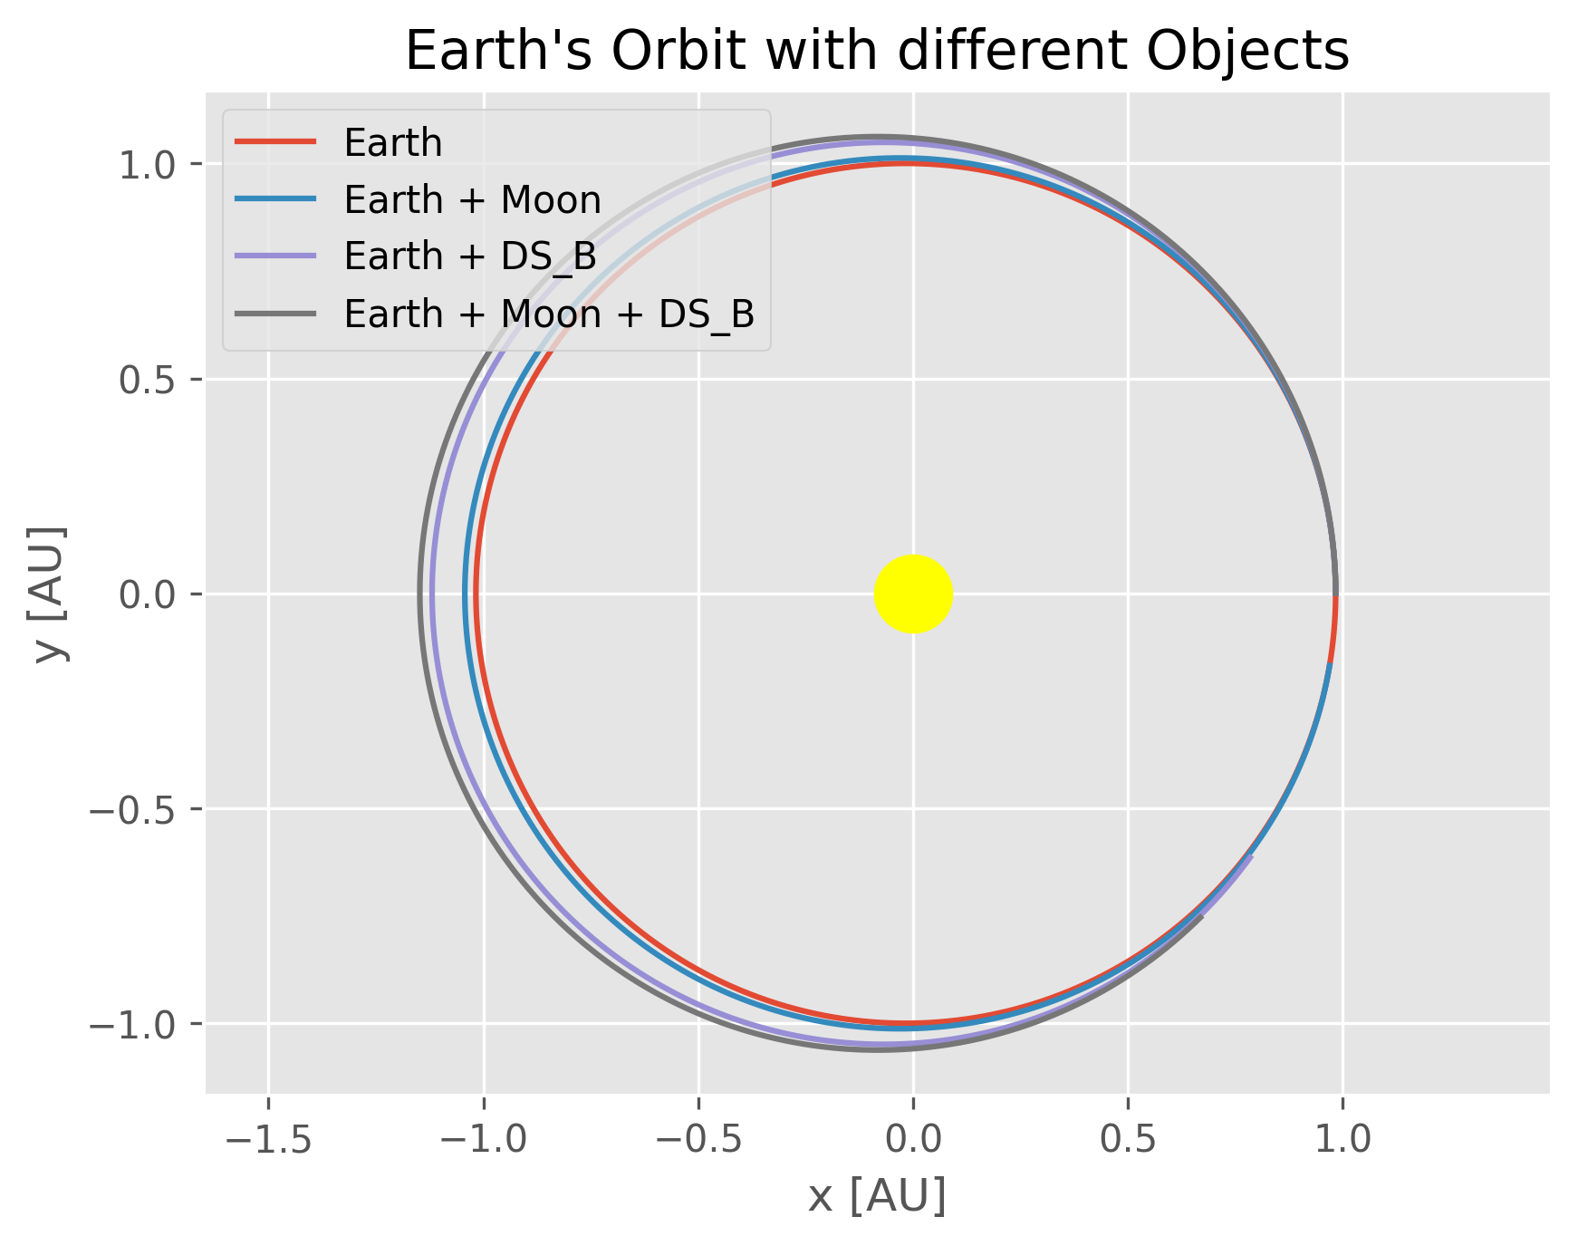
Orbital Effects of the Death Star
Results - Task 3 (Orbital Simulation)
The simulation demonstrates noticeable perturbations in Endor's orbit when influenced by the Death Star, whereas Earth's orbit remains relatively stable due to its greater distance and mass.

Slide 6
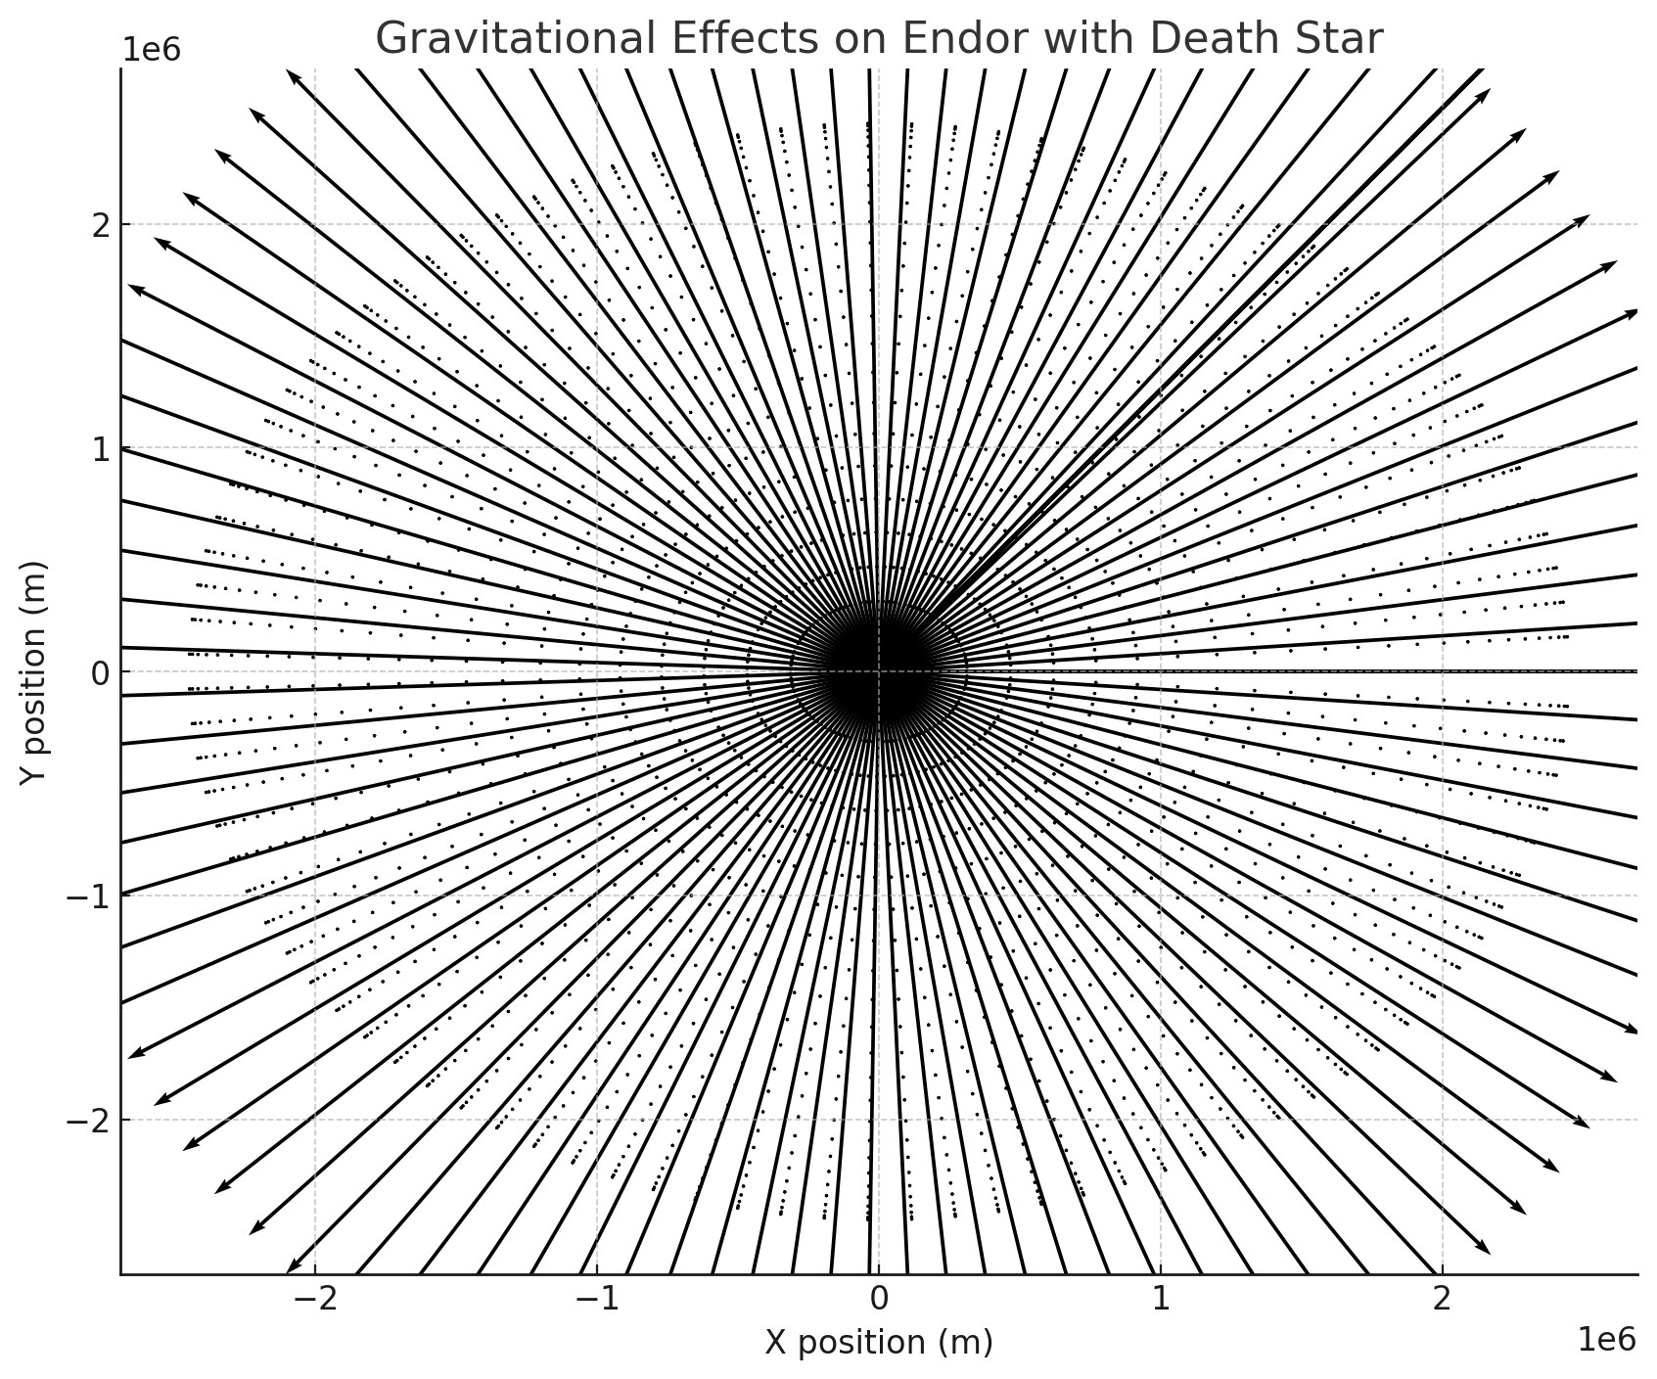
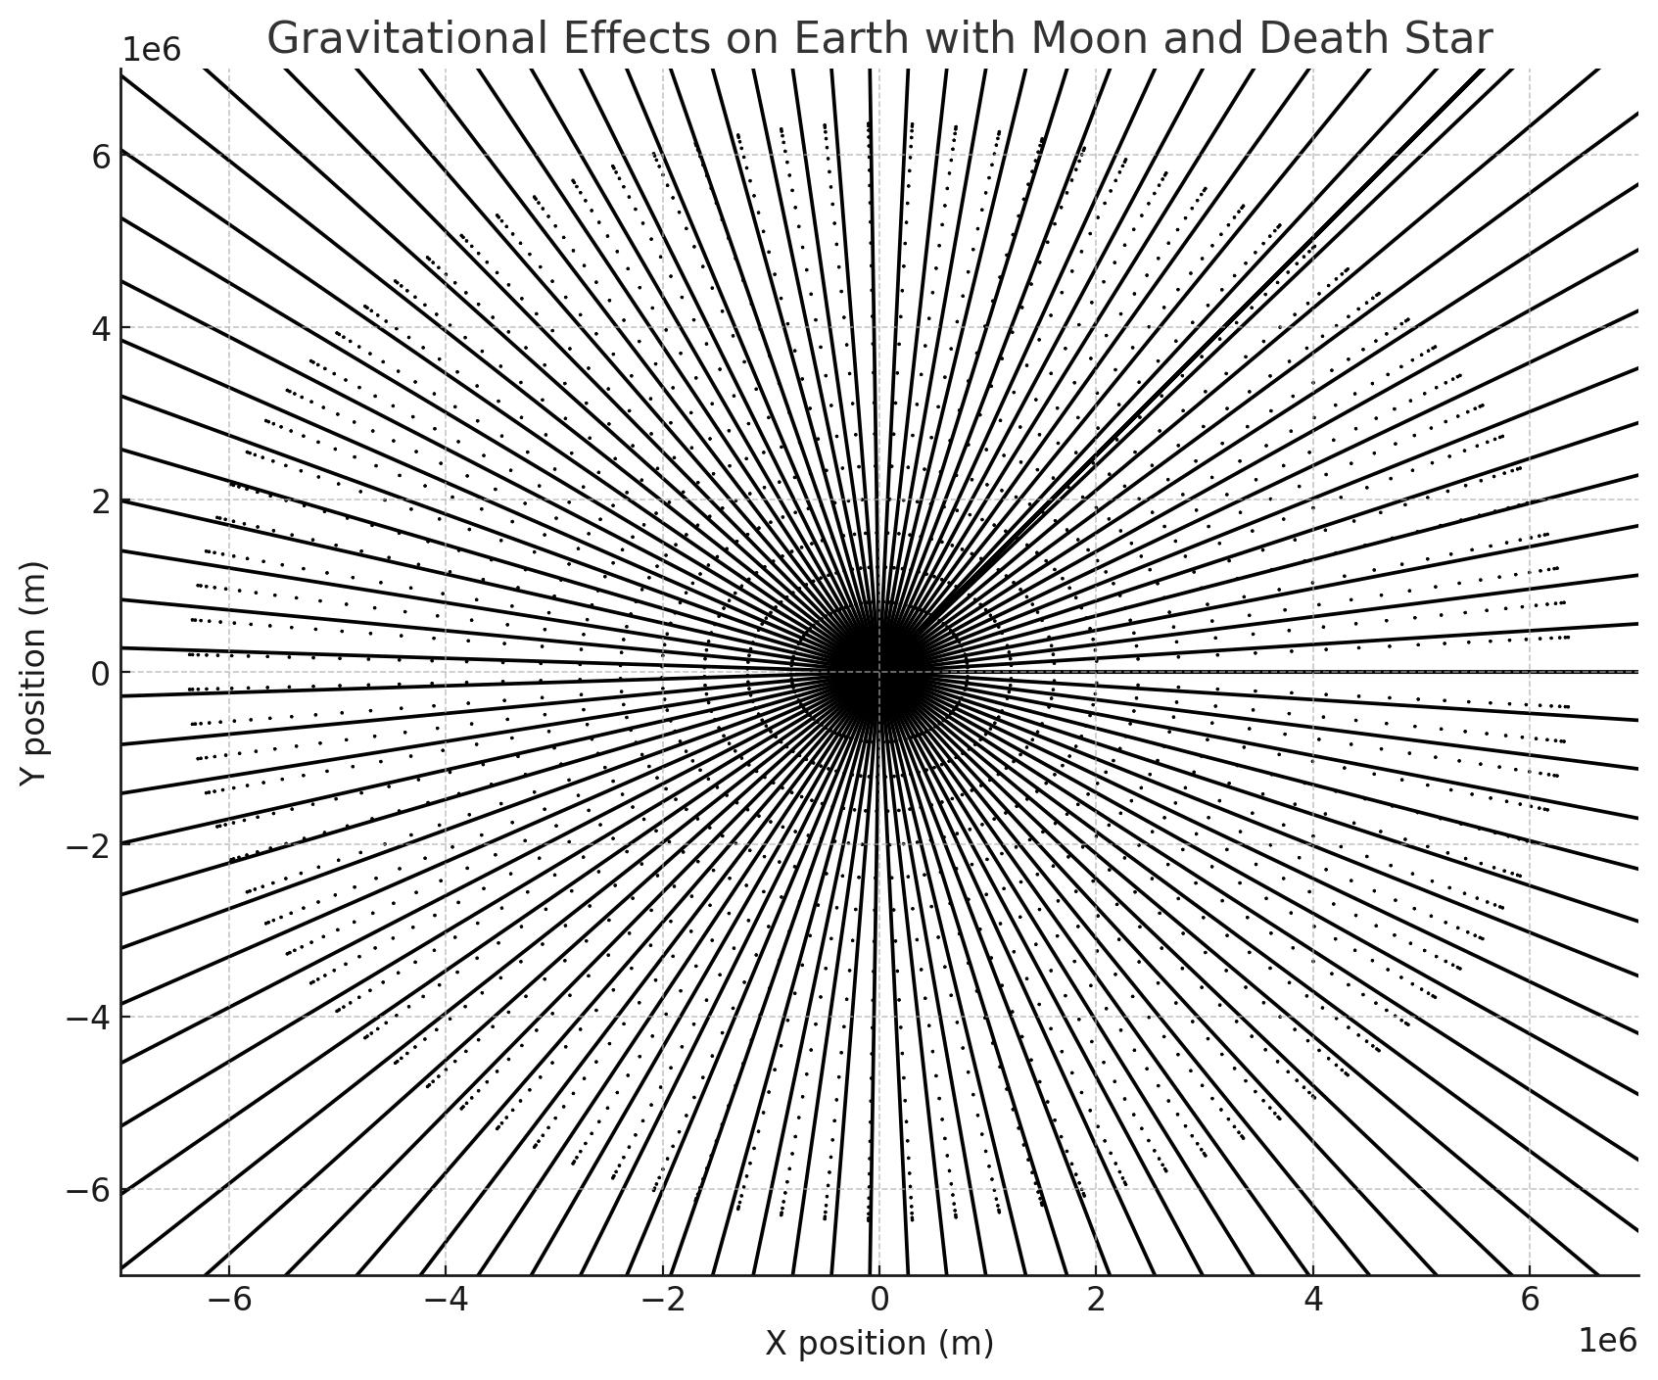
Gravitational Force and Tidal Changes
Results - Task 3 (Surface Gravitational Impact)
Gravitational force simulations indicate a significant increase in tidal forces on Endor due to the Death Star, contrasting with more subtle changes observed on Earth.
Notes:
> Moving to the third task, we analyzed the surface gravitational impact. The vector fields here represent the strength and direction of gravitational forces. The presence of the Death Star introduces significant changes, particularly around Endor, where tidal forces are visibly altered.
> This comparison helps us understand the potential environmental effects such large structures could have on a planet.

Slide 7
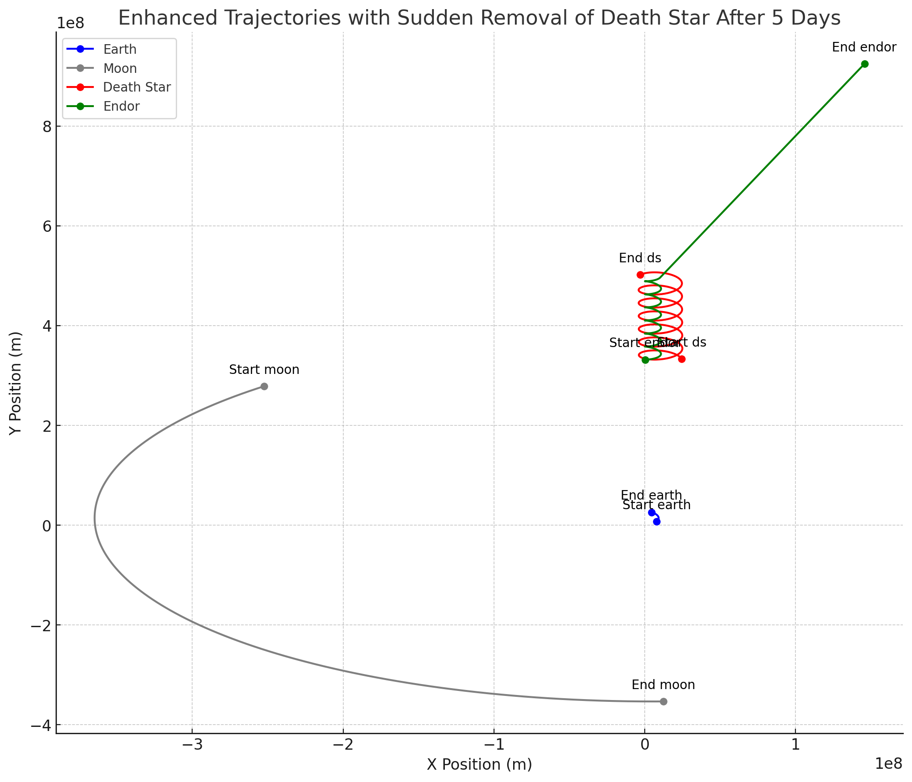
Implications of Death Star's Sudden Disappearance
Results - Task 4 (Sudden Disappearance)
The sudden removal of the Death Star leads to a temporary destabilization of Endor's orbit, demonstrating the significant gravitational influence exerted by the Death Star.
Notes:
> Finally, we explored what happens when such a massive body suddenly disappears. The trajectories post-removal show a temporary destabilization in Endor’s orbit, illustrating the abrupt removal of a significant gravitational pull.
> This scenario is crucial for understanding the dynamics of systems undergoing sudden mass loss.

Slide 8
Conclusions
The simulation showed significant gravitational effects of the Death Star on nearby planets, altering their trajectories and potentially causing orbital destabilization.
Successfully modeled and visualized the impact of the Death Star on celestial bodies' orbits.
Demonstrated how the sudden removal of a massive body affects planetary systems.
Notes:
> To conclude, our study has shown that the Death Star could have profound gravitational effects on nearby planets, affecting their orbits and potentially causing environmental changes through altered tidal forces.
> These findings underscore the importance of considering gravitational impacts in the design and placement of massive structures in space.

Slide 9
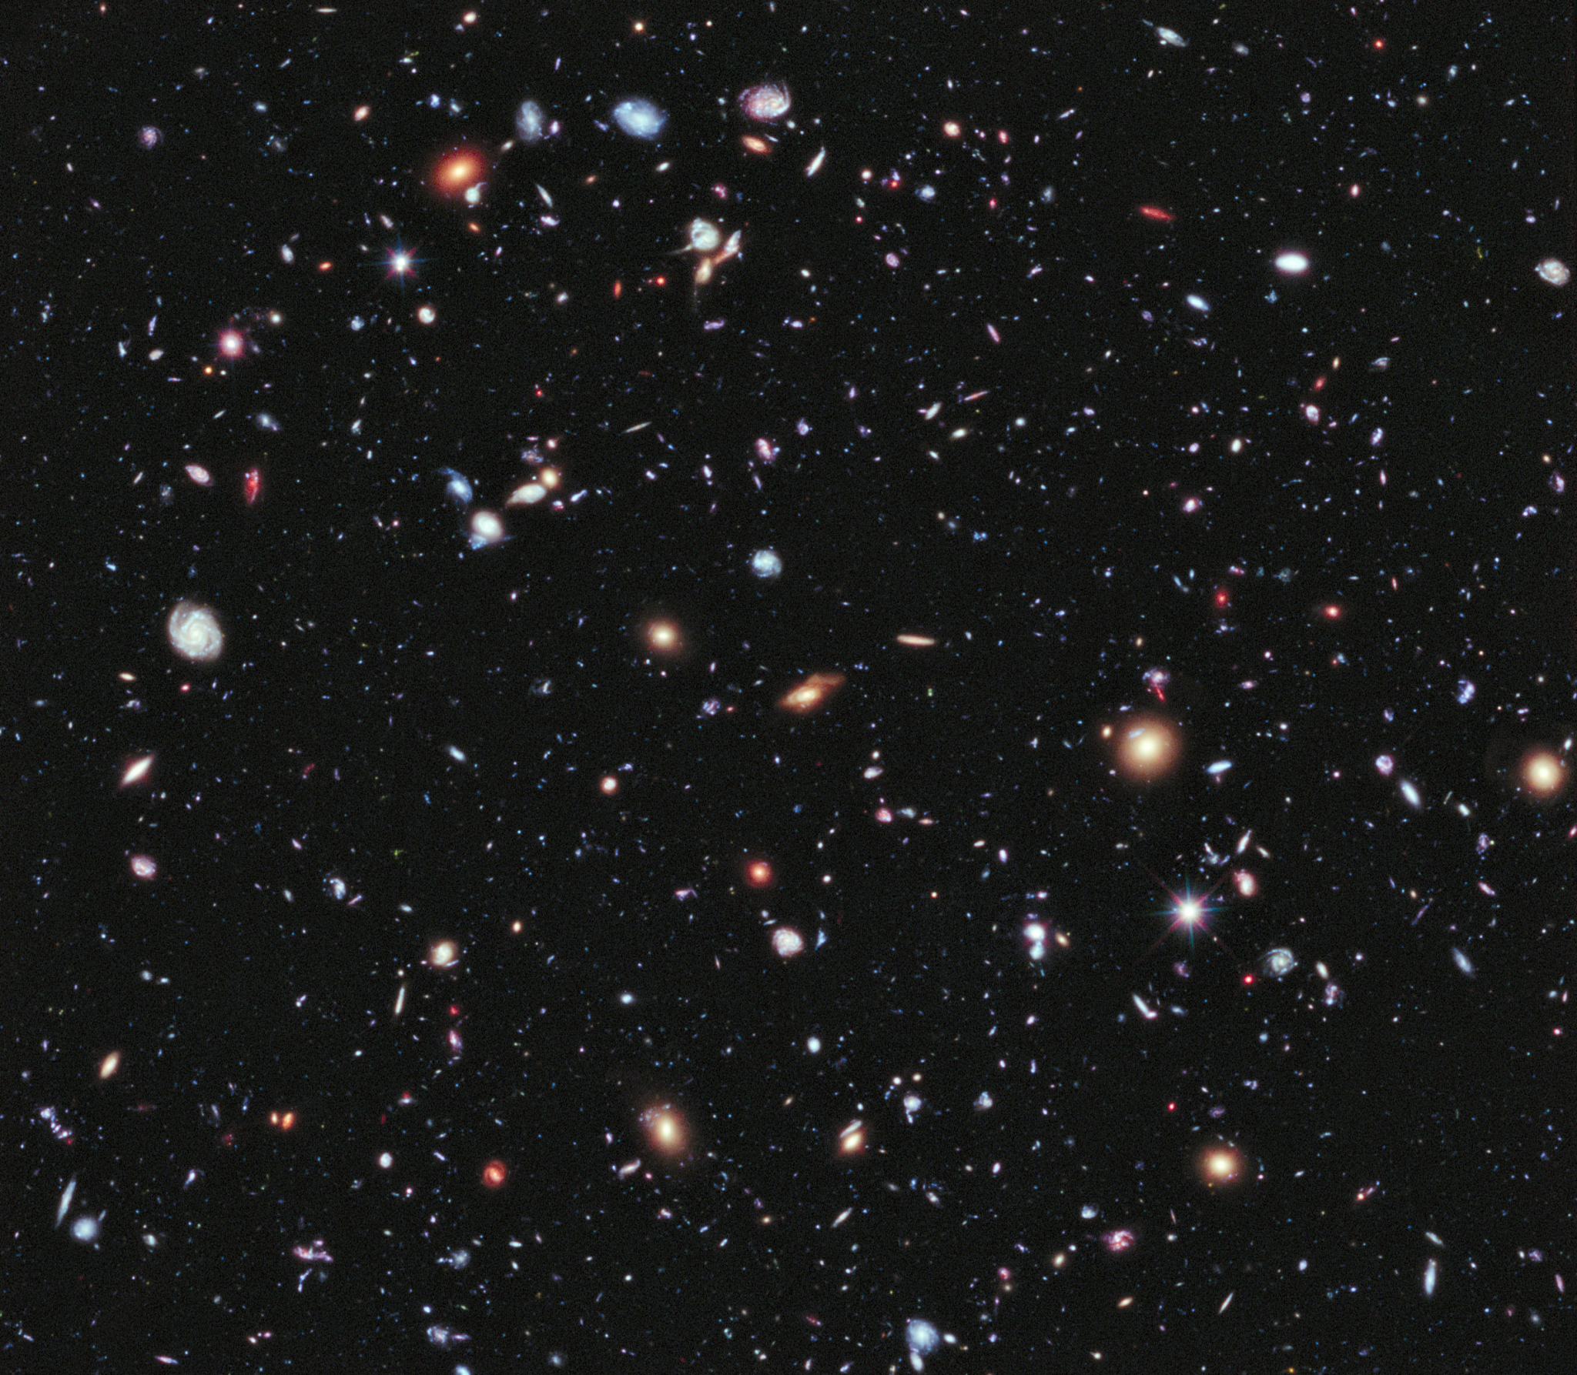
Future Work
Could include more bodies or consider non-circular orbits for further complexity and realism.

Slide 10
Acknowledgement
Dome, T., et al.: Mini-Quenching of z = 4 − 8 Galaxies by Bursty Star Formation. arXiv:2305.07066v2

Slide 11
References
Dome, T., et al.: Mini-Quenching of z = 4 − 8 Galaxies by Bursty Star Formation. arXiv:2305.07066v2

Slide 12

Questions

Slide 13
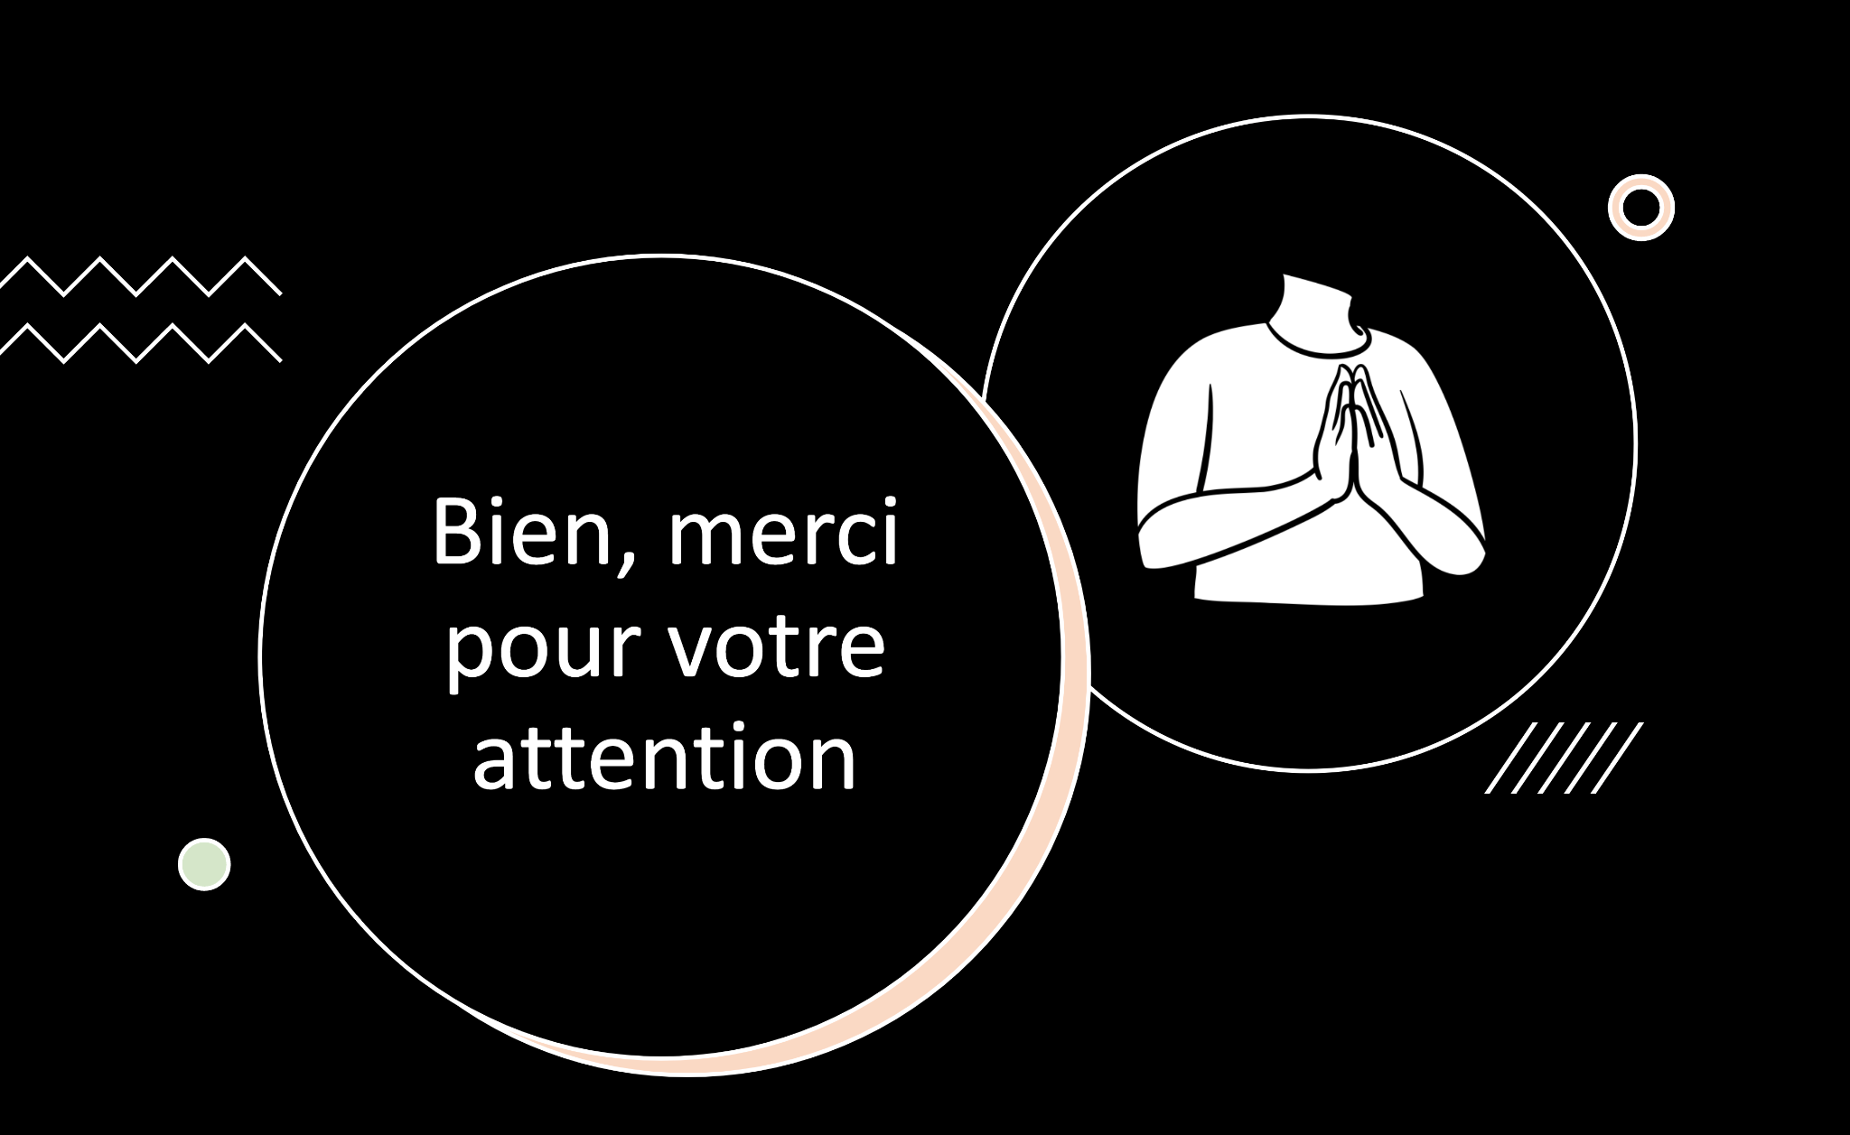
Notes:
Thank you for your attention.

